Slide 1
A1 Exercise 1
Name:
Look at the family tree and complete the sentences.
Sarah is John's sister.
Tom is Maria's son.
Lucy is Robert's granddaughter.
Fill in the blanks with the correct family member.
1. John is Sarah's _______.
2. Maria is Tom’s _______.
3. Robert is Lucy's ______.
Match the color to the correct word.
1. Red 2. Blue 3. Green 4. Yellow 5. Black 6. White
Complete the sentences with the correct words:
1. Hi, my name is ______.
2. I am from ______.
3. I have one ______.
4. Today is ______.
5. The sky is ______.

Slide 2
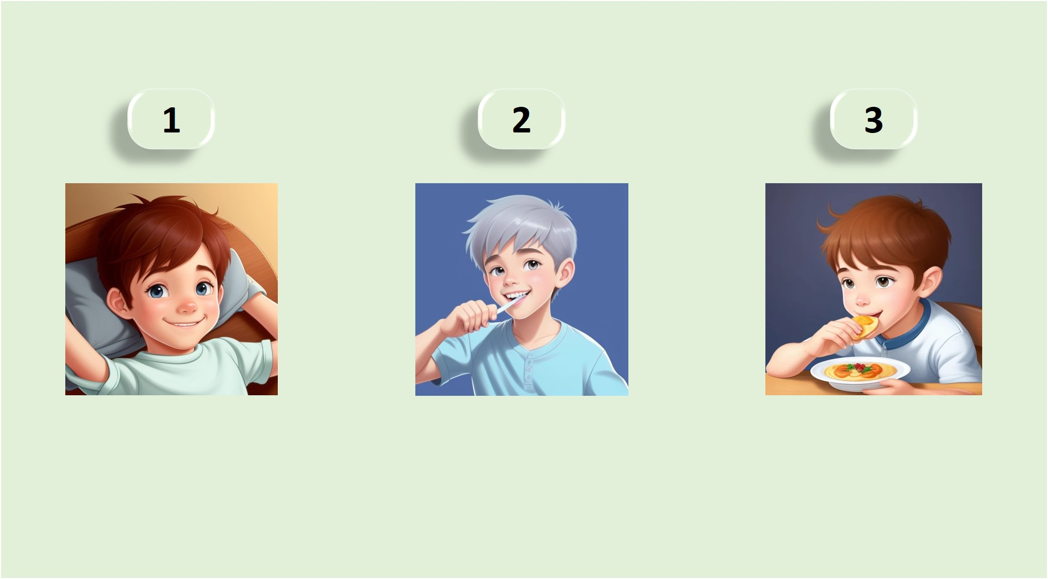
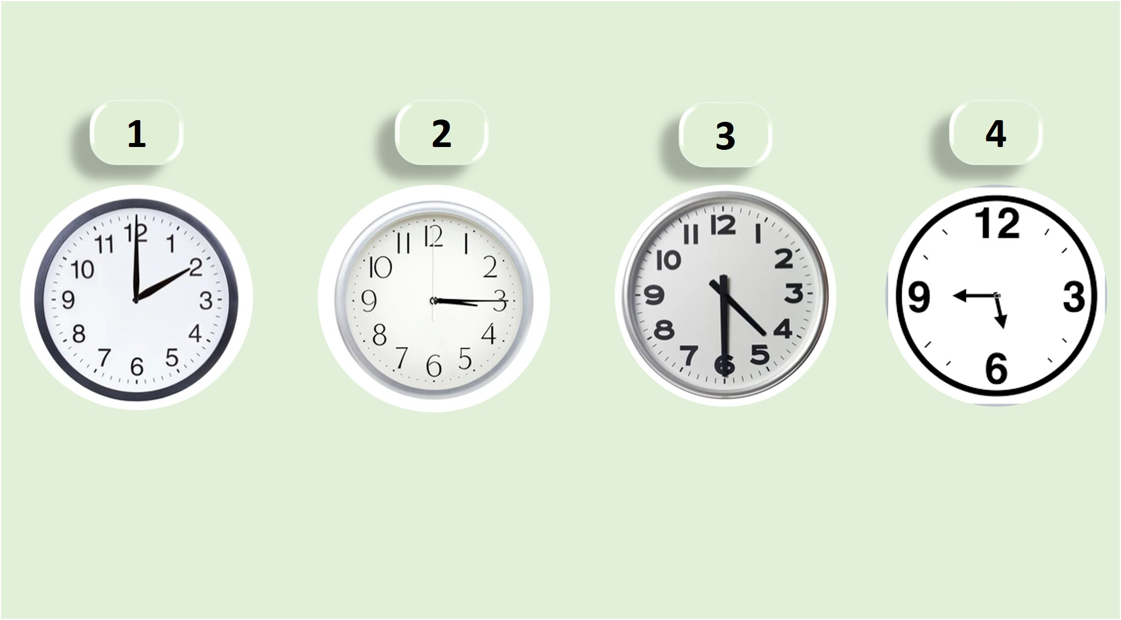
A1 Exercise 2
Name:
Vocabulary: Daily Routines
Match the routine with the correct picture.
_______
_______
_______
Telling Time
Look at the clocks and write the time.
1. _______
2. _______
3. _______
4. _______

Slide 3
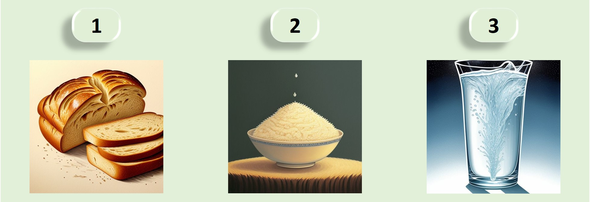
A1 Exercise 2
Name:
Vocabulary: Food and Drinks
Match the food or drink with the correct picture.
_______
_______
_______
Complete the sentences with the correct words
1. I ___ (wake up) at 6 AM.
2. She ___ (eat) breakfast at 8 o'clock.
3. They ___ (like) tea.
4. It is ___ (quarter past) nine.

Slide 4
A1 Exercise 3
Name:
Possessive Adjectives
Fill in the blanks with the correct possessive adjective.
1. This is ___ father.
2. Is that ___ brother?
3. ___ house is big.
Complete the sentences with the correct family member or possessive adjective:
1. This is ___ uncle.
2. ___ cousin is very funny.
3. ___ parents live in London.
4. John is my ___.
Write a short paragraph about your family.
Example
My family is big. I have two brothers and one sister. My father is a doctor, and my mother is a teacher. My best friend is Anna. We have been friends since childhood.

Slide 5
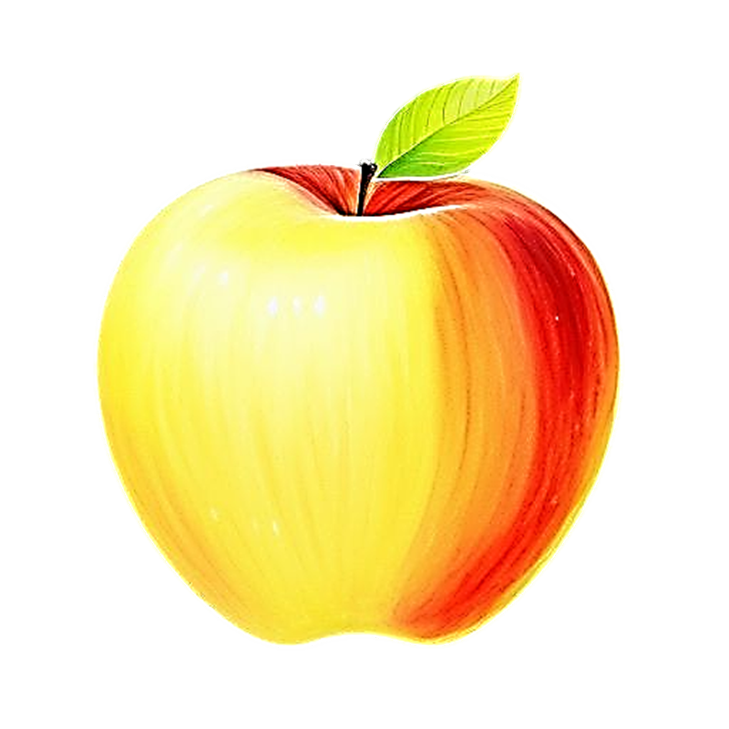
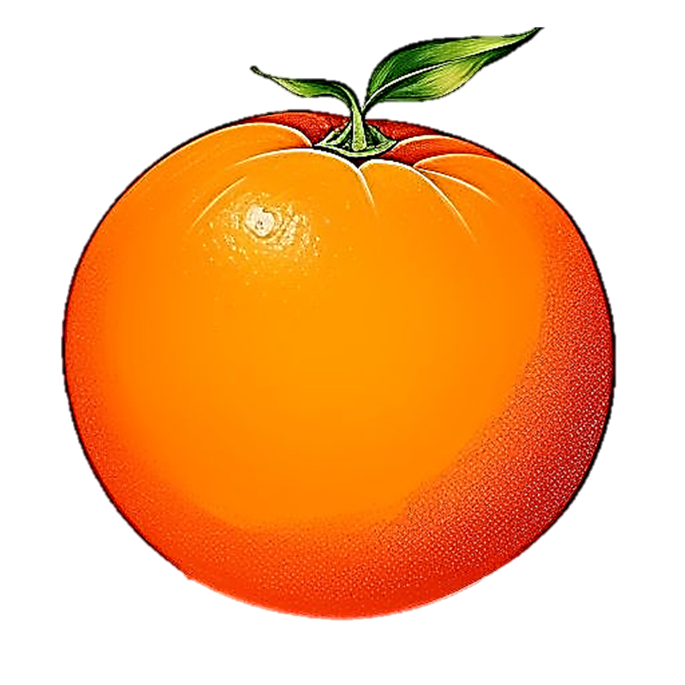
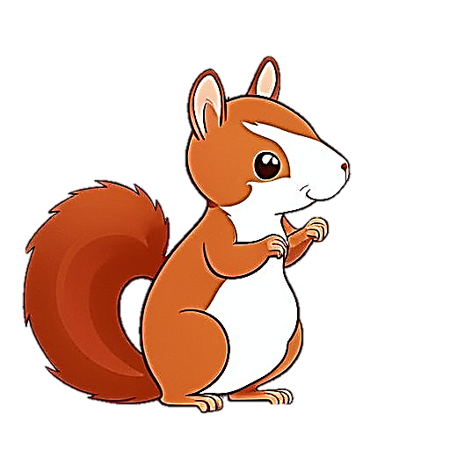
A1 Exercise 4
Name:
Counting Objects
Write the numbers and the nouns.
_____________
_____________
_____________
Plural Nouns
Change these singular nouns to plural nouns
1. Book - _____
2. Box - _____
3. Baby - _____
Irregular Plurals
Change these singular nouns to irregular plurals
1. Man - _____
2. Foot - _____
3. Child - _____

Slide 6
A1 Exercise 5
Name:
Countable and Uncountable Nouns
Classify the following as countable or uncountable
1. Orange - ______
2. Water - ______
3. Egg - ______
4. Sugar - ______
Talking About Quantities
Fill in the blanks with 'much' or 'many’
1. How ___ apples do you have?
2. How ___ milk do you need?
3. I don’t have ___ sugar.
4. We have ___ bananas.
Complete the sentences
1. I ___ (like) apples, but I ___ (not like) bananas.
2. How ___ (much/many) water do you drink every day?
3. She ___ (like) rice, but she ___ (not like) pasta.

Slide 7
A1 Exercise 6
Name:
Using “to be” with adjectives
Completing the sentences with the correct “to be” form
She ___ beautiful.
They ___ happy.
3. I ___ tired.
Demonstrative Pronouns: This, These, That, Those
Choose the correct demonstrative pronoun for each sentence
1. ___ is my pen. (near)
2. ___ is her house. (far)
3. ___ are your books. (near)
4. ___ are their bags. (far)
Write a short paragraph describing a person or a thing
Example
This is my cat. He is small and white. That is his favorite toy. It is red and round. These are his friends. They are also cats and they are very playful.

Slide 8
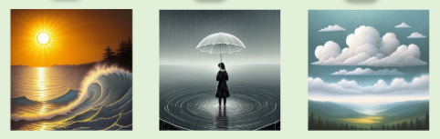
A1 Exercise 7
Name:
Vocabulary: Weather
Match the weather word with the correct picture
Cloudy
Sunny
3. Rainy
Seasons and Weather
Match the season with the typical weather
Summer
Winter
Autumn
Cold and snowy
Cold and windy
Hot and sunny
Write a short paragraph about the weather in your city for the next three days. Use the weather vocabulary and present continuous tense
Example
Today, it’s cloudy and cool. Tomorrow, it’s going to be sunny and warm. On the third day, it will be raining in the morning and windy in the afternoon.

Slide 9
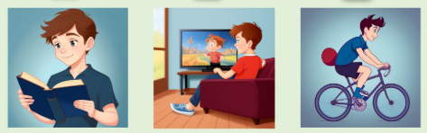
A1 Exercise 8
Name:
Vocabulary: Hobbies
Match the hobby with the correct image
Cycling
Reading
3. Watching T.V
Simple Present Tense for Hobbies
Fill in the blanks with the correct form of the verb:
She ___ (enjoy) playing tennis.
I ___ (like) reading books.
They ___ (watch) TV every night.
Write a short paragraph about your favorite hobby.
Example
My favorite hobby is playing the guitar. I play every evening after work. I enjoy it because it helps me relax.

Slide 10
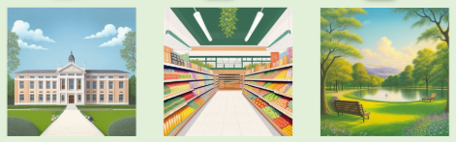
A1 Exercise 9
Name:
Vocabulary: Places in Town
Match the place with the correct image
Supermarket
Park
School
Prepositions of Place
Fill in the blanks with the correct preposition:
The park is ___ the school.
The bank is ___ Main Street.
The library is ___ the school.
Draw a simple map of your town or neighborhood.
Label the different places and write directions from your house to one of the places on your map.
Example
Draw your house, school, supermarket, and park.
‘Go straight, turn left at the school, and the park is on your right.’

Slide 11
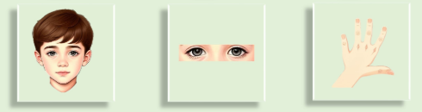
A1 Exercise 10
Name:
Vocabulary: Body Parts
Label the body parts in the diagram
1. Eyes | 2. Hand | 3. Head
Vocabulary: Basic Health
Match the health word with the correct definition:
A person who helps you when you are sick.
Something you take to feel better.
When your body temperature is high.
1. Fever | 2. Doctor | 3. Medicine
Write a short paragraph about a time when you were sick.
Example
Last month, I had a cold. I had a sore throat and a cough. I took some medicine and rested at home. After a few days, I felt better.

Slide 12
A1 Exercise 11
Name:
Vocabulary: Shopping
Match the word with its definition
1. A place where you buy things.
2. The person who takes your money.
3. A paper that shows what you bought and how much you paid.
1. Cashier | 2. Receipt | 3. Store
Complete the sentences with the correct word
I’ll take ___.
How much ___ this?
Do you have a ___?
1. is | 2. bag | 3. it
Write a short dialogue between a customer and a salesperson in a store.
Example
Customer: How much is this book?
Salesperson: It’s $10.
Customer: I’ll take it. Here’s the money.
Salesperson: Here’s the receipt. Thank you!

Slide 13
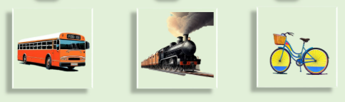
A1 Exercise 12
Name:
Vocabulary: Transportation
Match the word with the correct picture
1. Train | 2. Bicycle | 3. Bus
Write a short paragraph about a recent trip you took
Include the transportation you used, where you went, and how you got there. Practice reading it aloud.
Example
Last weekend, I went to the beach. I took a bus to the city center and then walked to the beach. It was a beautiful day!

Slide 14
A1 Exercise 13
Name:
Vocabulary: School-Related
Match the school-related word with its definition
1. A person who helps students learn.
2. Work that students do at home.
3. A room where students have lessons.
1. Homework | 2. Classroom | 3. Teacher
Vocabulary: School Subjects
Match the subject with what it studies
1. The study of numbers and calculations.
2. The study of the natural world.
3. The study of past events.
1. Science | 2. History | 3. Math
Complete the sentences with the correct past tense verb
1. I ___ (study) for my exam yesterday.
2. We ___ (learn) about animals in science class.
3. She ___ (play) soccer after school.
Write a short paragraph about what you did at school yesterday. Include the subjects you studied and any activities you did. Practice reading it aloud.
Example
Yesterday, I studied math and learned about history. After school, I played soccer with my friends.

Slide 15
A1 Exercise 14
Name:
Vocabulary: Job and Workplace
Match the job with its workplace
1. Hospital
2. School
3. Store
1. Teacher | 2. Cashier | 3. Teacher
Present Simple Tense for Routines
Complete the sentences using the correct form of the verb:
1. I ___ (work) in a store.
2. She ___ (teach) math.
3. They ___ (design) cars.
Practice talking about your current job or what you want to do in the future with a partner
Example
A: What do you want to do in the future?
B: I want to be an engineer because I like designing things.

Slide 16
A1 Exercise 15
Name:
Vocabulary: Rooms
Match the room with its description
1. A room where people sleep.
2. A room where food is cooked.
3. A room where people relax.
1. Living room | 2. Bedroom | 3. Kitchen
Vocabulary: Furniture
Match the furniture with the room it is usually found in
1. Bed
2. Sofa
3. Table
1. Living room | 2. Bedroom | 3. Dining room
Complete the sentences with 'there is' or 'there are'
1. ___ a sofa in the living room.
2. ___ three bedrooms in my house.
3. ___ a table in the kitchen.
Write a short paragraph describing your home using
'there is' or 'there are'
Example
In my house, there are two bedrooms and a living room. There’s a sofa and a T.V in the living room. There’s a table in the dining room. In the kitchen, there are four chairs around the table.

Slide 17
A1 Exercise 16
Name:
Vocabulary: Holidays and Celebrations
Match the celebration with its description
1. A holiday on December 25th.
2. The day you were born.
3. A ceremony where two people get married.
1. Birthday | 2. Wedding | 3. Christmas
Simple Present Tense for Regular Events
Complete the sentences using the correct form of the verb
1. I ___ my birthday every year.
2. We ___ the house for Christmas.
3. They ___ their grandparents on Thanksgiving.
1. Decorate | 2. Visit | 3. Celebrate
Write a short paragraph about your favorite holiday.
Include details about how you celebrate it and why you like it
Example
My favorite holiday is New Year’s Eve. I like it because I get to stay up late and watch fireworks. We have a party with friends and we all celebrate together. It’s a lot of fun!

Slide 18
A1 Exercise 17
Name:
Vocabulary: Restaurants
Match the vocabulary with the correct definition
1. The person who takes your order.
2. A list of food and drinks.
3. A sweet dish at the end of a meal.
1. Menu | 2. Dessert | 3. Waiter
Ordering Food and Drinks
Fill in the blanks with the correct phrase
1. I’d like ____, please.
2. Can I have ____, please.
3. I’ll have ____, please.
1. the burger | 2. the pizza | 3. a glass of water
Describe the following dishes using the adjectives
The ice cream is ____.
The pizza is ____.
The curry is ____.
1. tasty | 2. spicy | 3. sweet

Slide 19
A1 Exercise 18
Name:
Adjectives for Describing Places
Match the adjective with the correct description
1. Very attractive and pleasing to look at.
2. A place with a lot of people.
3. A place with little noise.
1. Quiet | 2. Beautiful | 3. Crowded
Comparatives and Superlatives
1. The city is ___ (big) than the town.
2. This is the ___ (beautiful) place I’ve ever seen.
3. The park is ___ (quiet) than the street.
Write a short paragraph comparing two places you know.
Use comparatives and superlatives to describe them
Example
The park is quieter than the city center, but the city center is more exciting. The park is the best place to relax, while the city center is the best place to shop.

Slide 20
A1 Exercise 19
Name:
Vocabulary: Common Activities
Match the activity with the correct description
1. To prepare food.
2. To make something clean.
3. To do physical activities.
1. Exercising | 2. Cooking | 3. Cleaning
Simple Present Tense for Routines
Complete the sentences with the correct form of the verb
1. She ___ (clean) her room every day.
2. We ___ (cook) dinner together on weekends.
3. They ___ (study) English after school.
Write a short paragraph about your daily routine.
Use the simple present tense to describe what you do from morning to night.
Example
I wake up at 6:30 AM and have breakfast. After that, I go to work and come home at 5:00 PM. In the evening, I cook dinner and watch TV before going to bed.

Slide 21
A1 Exercise 20
Name:
Review of Key Vocabulary
Match the vocabulary word with its correct definition
1. A place where you buy food.
2. Weather with rain.
3. A person who helps you when you are sick.
1. Doctor | 2. Supermarket | 3. Rainy
Review of Key Grammar
Fill in with the correct form of the verb or preposition
1. He ___ (go) to school every day.
2. There ___ (be) three books on the table.
3. The ball is ___ (on/under) the table.
Dialogue Practice
A: What do you do in the morning?
B: I Usually ____ at 7:00 and then ____ breakfast.

